Slide 1
HTML
Դաս։ 11 Animations

Slide 2
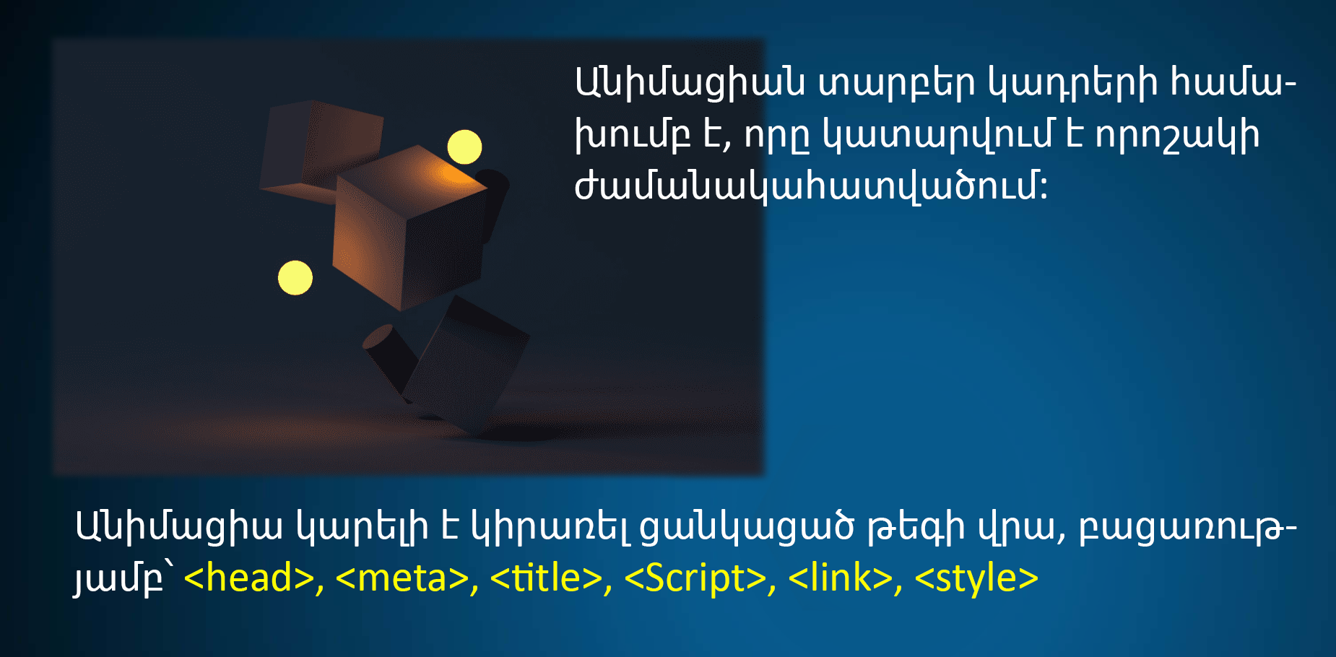
CSS Animation

Slide 3
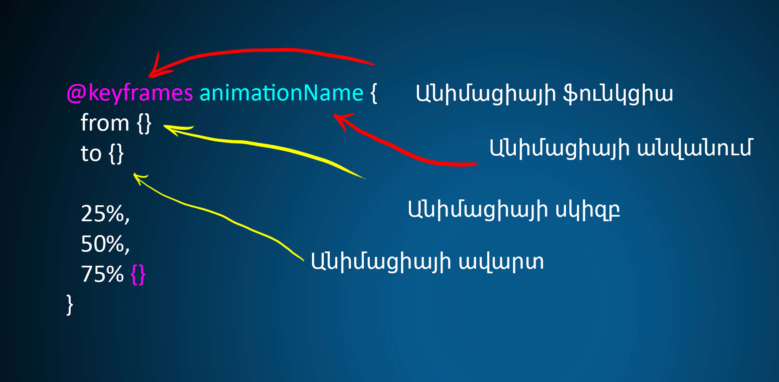
CSS Animation

Slide 4
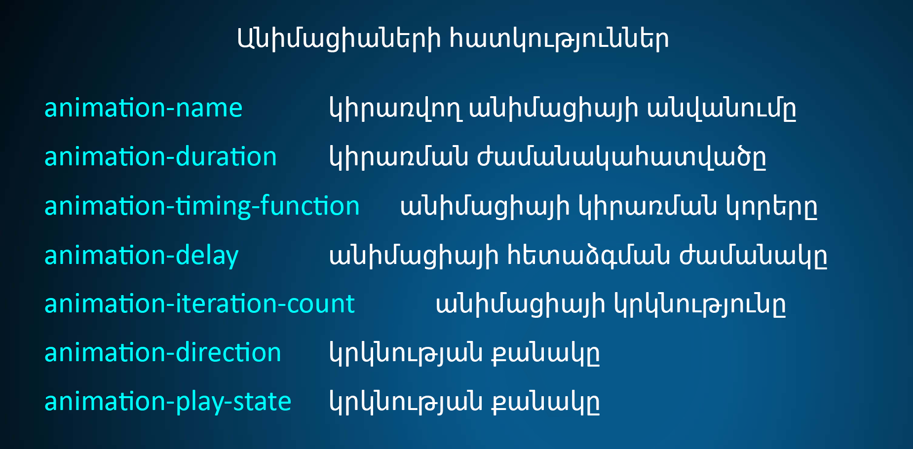
CSS Animation

Slide 5
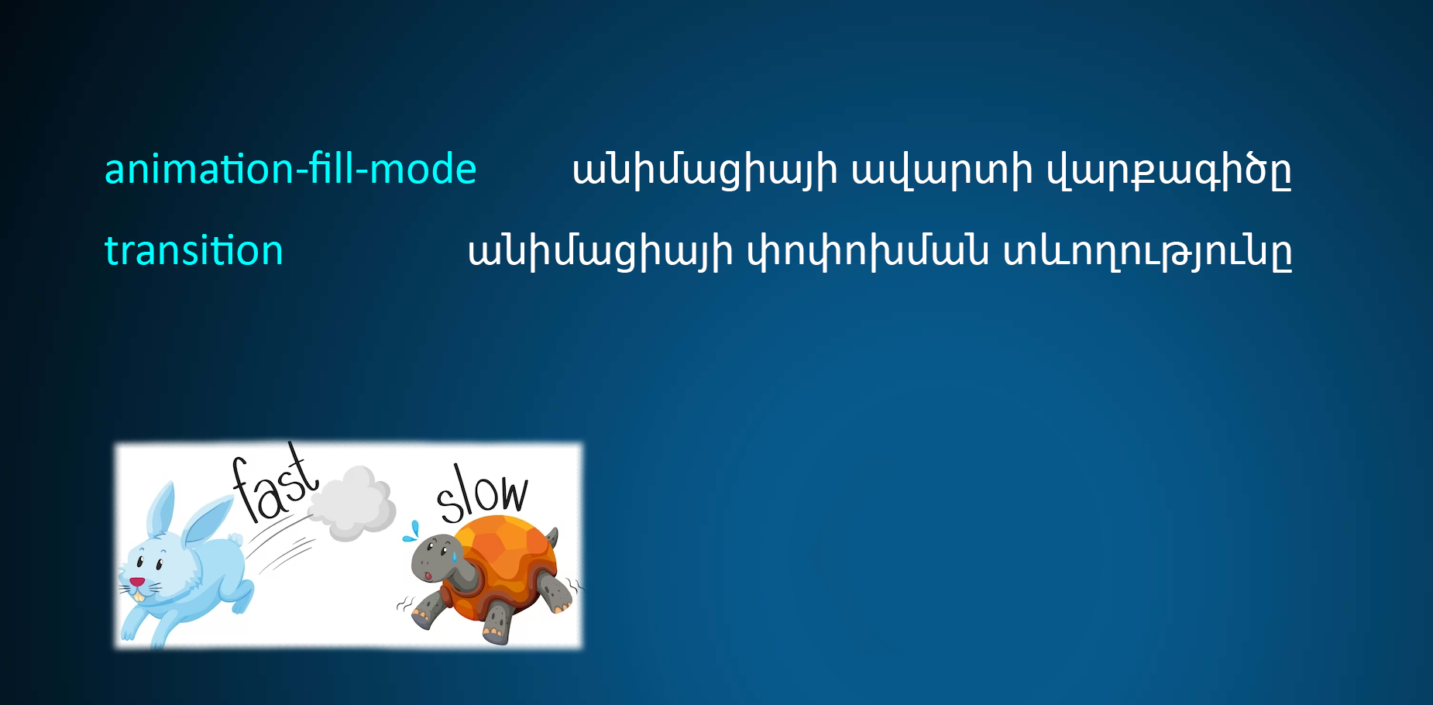
CSS Animation

Slide 6
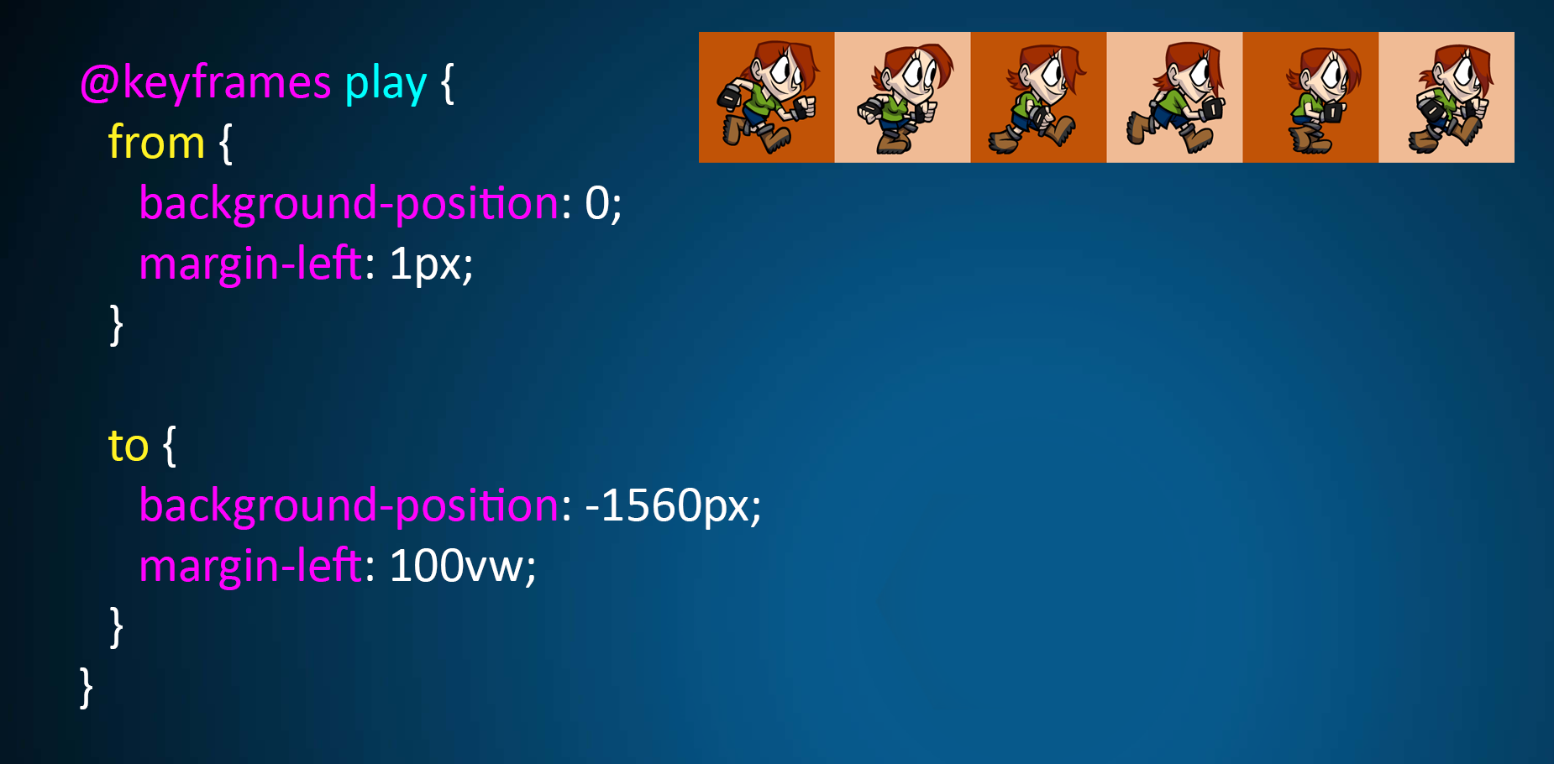
CSS Animation

Slide 7
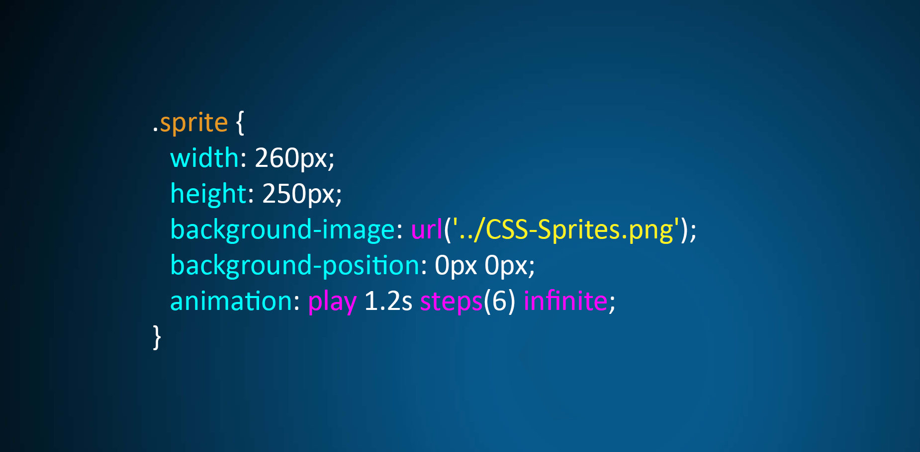
CSS Animation

Slide 8
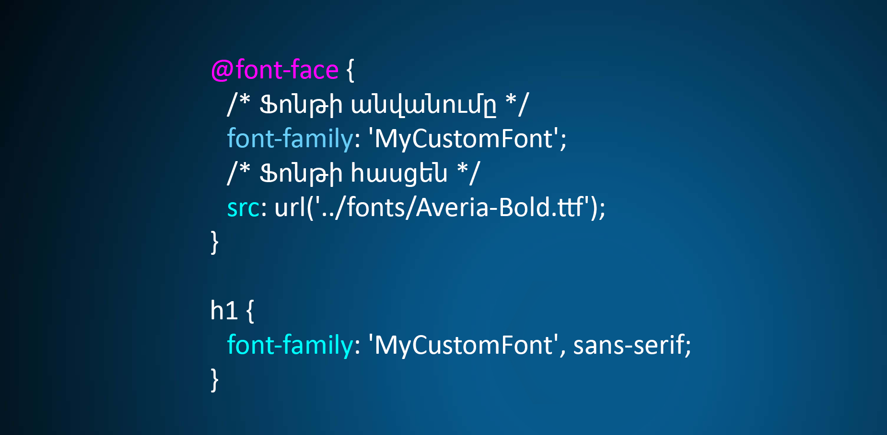
CSS Animation

